Slide 1
Preliminary look at comparing Soar to other modeling method
Jacob Crossman (jcrossman@soartech.com)
Bob Marinier, Alex Pritchard, Mike Quist, Matt Hollingsworth

Slide 2
Introduction: What/Why
Empirically compare behavior development in Soar v. other approaches
Help understand Soar’s benefits and limitations at a concrete level
Help with arguments to customers – why use Soar as an engineering solution?
Help provide a concrete understanding of Soar’s design patterns (learning to use Soar well)

Slide 3
Major Comparative Study Options
Dimension | One extreme | Other extreme
Problem Type | Turn Based | Real-time
Problem Complexity | Simple | Complex
Design Constraints | Rigid (same strategies, data structures, etc) | Free (each developer choses own strategy, etc)
Comparison Architecture | Other CAs (e.g. ACT-R) | Other architectures (von Neumann, FSM)
Developer Distribution | One dev does everything | Each dev does one thing

Slide 4
Measuring Results
Development Effort
Time (to build, modify)
Lines of code
Structures
Logic
Completed functions
Execution
Success rates
Computational time
Patterns
Infrastructure developed/reused
Type of designs used

Slide 5
Our Pilot Study
Our Configuration Choices
Domain: TankSoar, fine granularity turn based
Complexity: Closer to simple
Design Constraints: Closer to free
Comparison Architecture: Other architectures – JVM with Java, FSM (using a Javascript library we developed), CSoar
Developer Distribution: Each dev does one method
Tasks: Developers were asked to develop the following, where there were some constraints on each
Explore, Attach, Defend, Retreat
Map
Obtain resources
(Options) Chase, Ambush, Predict opponent next move
Each developer given 40 total hours for design, implementation, test, log (24 for implement/test)

Slide 6
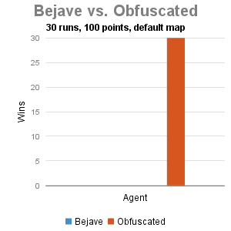
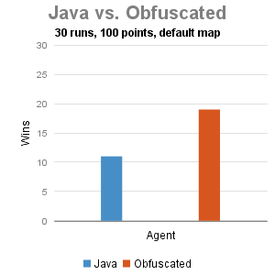
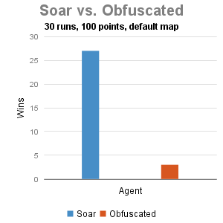
Effectiveness Measure
All evaluation against the tutorial’s obfuscated agent
Soar performed best – believe this is due to its strong defend strategy
Bejave could not handle sound and smell well. Lacked the sophisticated higher-level decision process of the Java and Soar agent – less well tested.

Slide 7
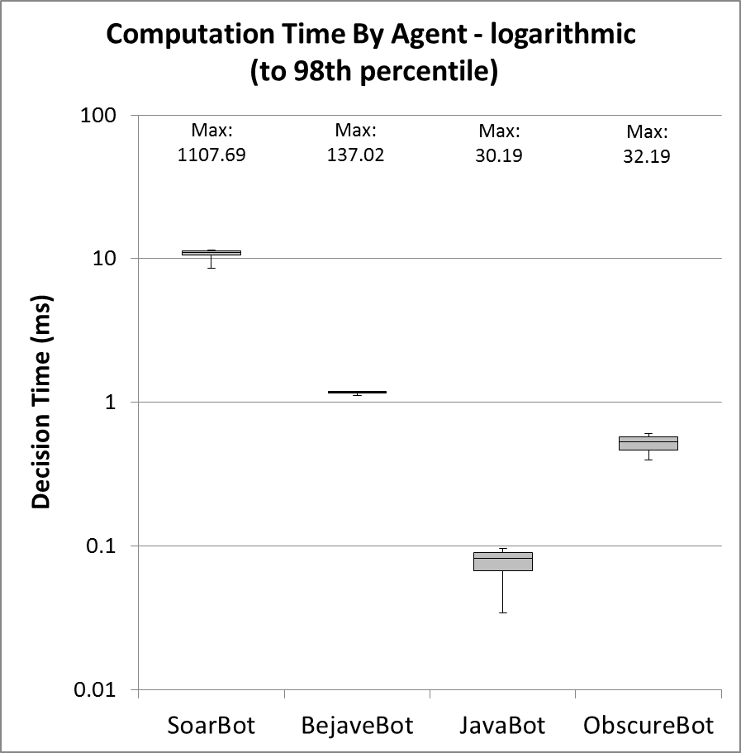
Computation Time
JavaBot performs best, but ObscureBot (Soar) is also fast
All bots had rare very slow decisions relative to median
SoarBot: 100x, BejaveBot: 100x, JavaBot: 375x, ObscureBot: 60x
SoarBot may have had a few slow rules (inductive rules for comp. distances?)

Slide 8
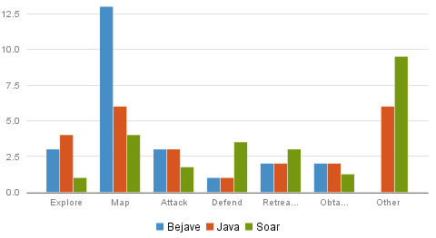
Time Spent by Task
Time on “other” may be a factor in success rate
Differences probably reflect developer’s strategy, not architecture
Exception: Bejave - spent lots of time on basic infrastructure – logged to mapping task – for example path finding and graph construction
Other time: is mostly used for the “top level” goal – choosing which of the sub-goals to execute – consists mainly of understanding the situation

Slide 9
Subjective Design Thoughts
 | Nuggets | Coal
Bejave (FSM) | Mapping behaviors to states Good at selecting state | Limited to core JavaScript Extraneous code to handle trivial behavior mappings Vague dependency management / poor IDE support made using unfamiliar API challenging
Java | Good core library support Compiled, fast performance Strong IDE helped with unfamiliar API | Goal selection required additional programming overhead Large amount of sensor data resulted in complex code
Soar | Good at making complex decisions with disparate information Group productions based on logical connection without dependency limitations | Poor pathfinding performance (easy to write, inefficient to execute algorithm) Non-linear logic can be hard to debug
Note: Quantity of code essentially the same for all

Slide 10
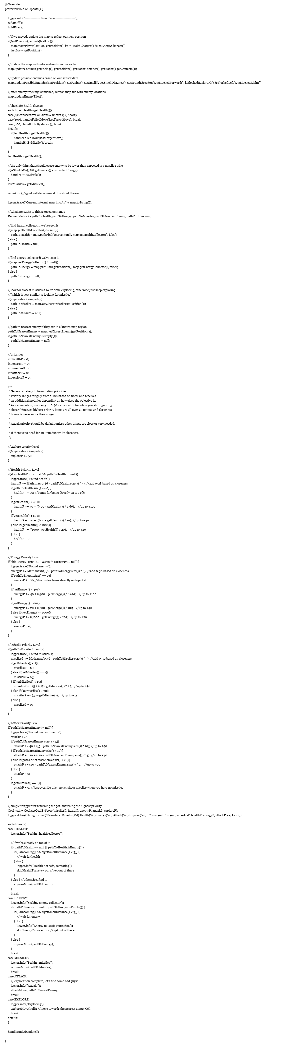
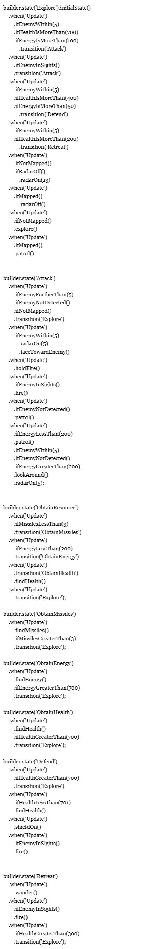
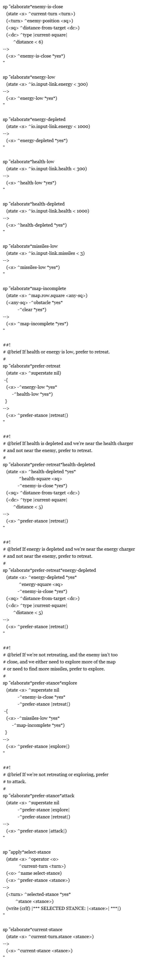
Code Structure
Java
Bejave
Soar
Sequence encodes
decision cycle
Architecture encodes decision cycle
Architecture encodes decision cycle
No inferences
Behavior execution and goal selection intermixed
Sequence encodes preferences
Goal Selection: In middle of code (call to separate function)
Goal Selection: Architectural
Behavior execution: separate function for each goal
Behavior execution: separate file for each goal
Inferences
Goal Preferences
Behavior Execution
Goal Selection
Decision Cycle
Notes:
Java:
Likely to scale less well
May not do well in more continuous environment

Slide 11
Resulting (Post-hoc) Hypotheses
Real-time decision-making agents are easier to implement in Soar due to its general, prebuilt architectural mechanism
Implementing decision-making agents requires duplicating at least some of the functionality in Soar
Decision-making agents need a decision cycle
Decision-making agents need a decision procedure
Decision-making agents need to be scalable
Robust decision making requires hierarchical perception and decisions that Soar makes easier
It is easier to integrate learning and decision making into a Soar system than to comparison systems

Slide 12
Nuggets/Coal
Nuggets
Coal
Derived some hypotheses that we can further test
Created a study structure from which we can gather more data
Valuable for new developers to try on their own
Not enough data to make important conclusions
We need to increase behavior complexity
Larger scale tests are expensive

